Slide 1
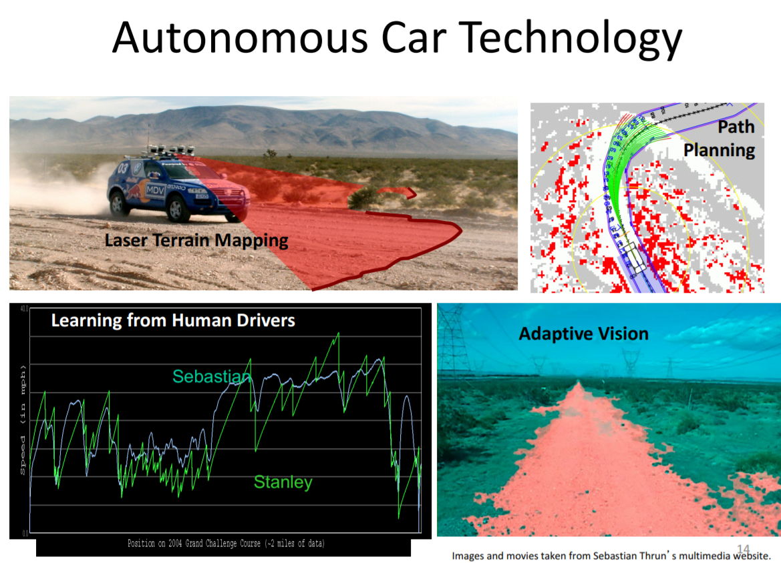
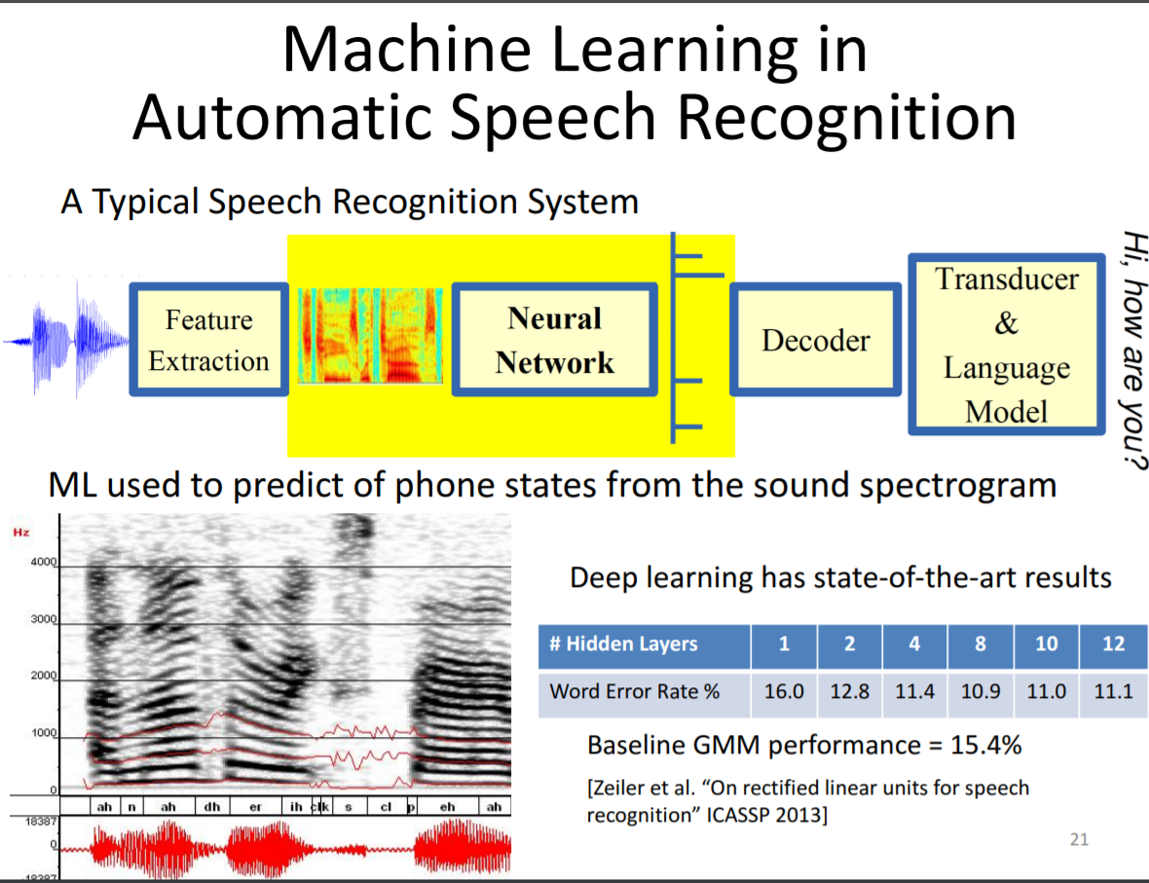
深度学习 Deep Learning
Why deep learning？

Slide 2
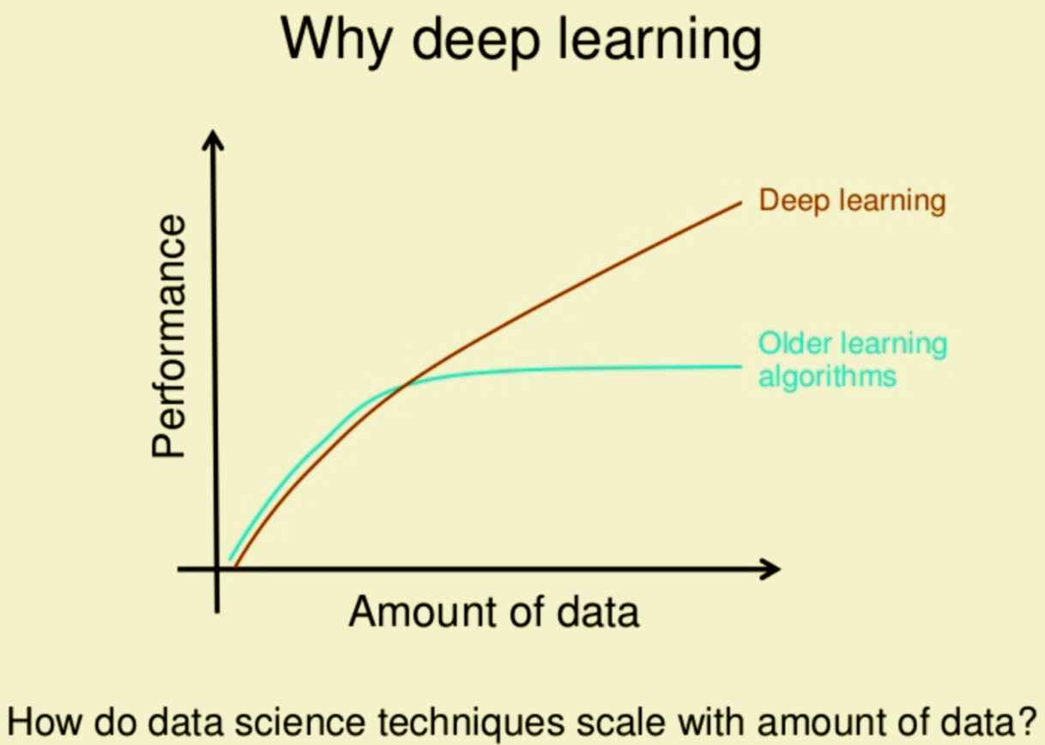
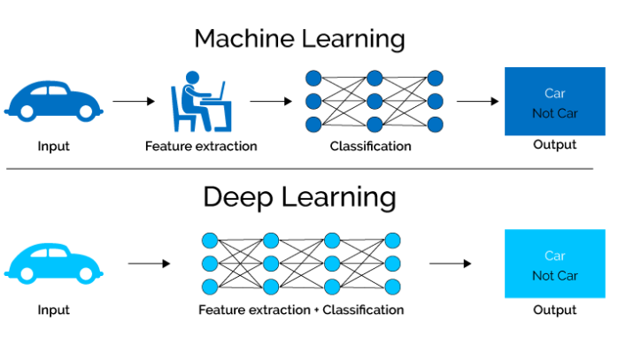
Why deep learning (below is only partly true)
Remember the feature engineering we did in previous class?
When it’s hard to extract meaningful low dimension features.
When there are lots of features
When there are lots of samples

Slide 3
Deep learning is deep neural network
But what is a neural network

Slide 4
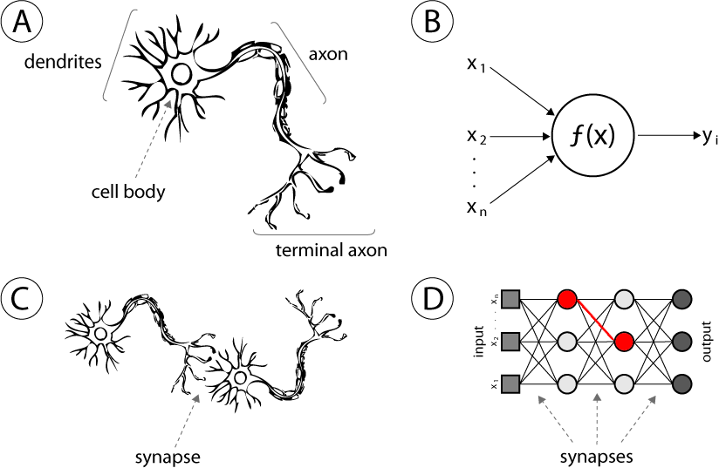
人工神经网络基本结构
树突
轴突
树突
轴突
细胞体
突触
突触

Slide 5
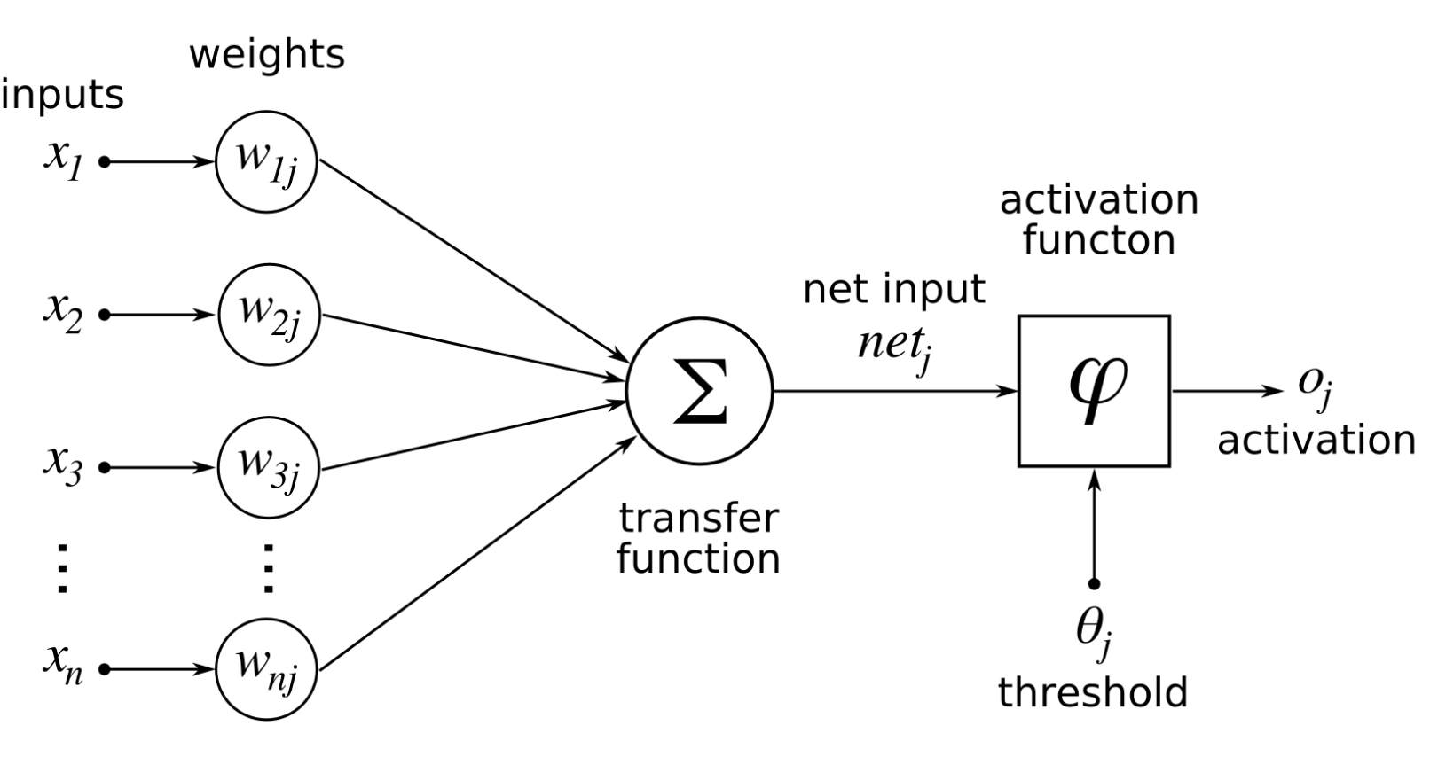
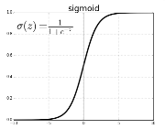
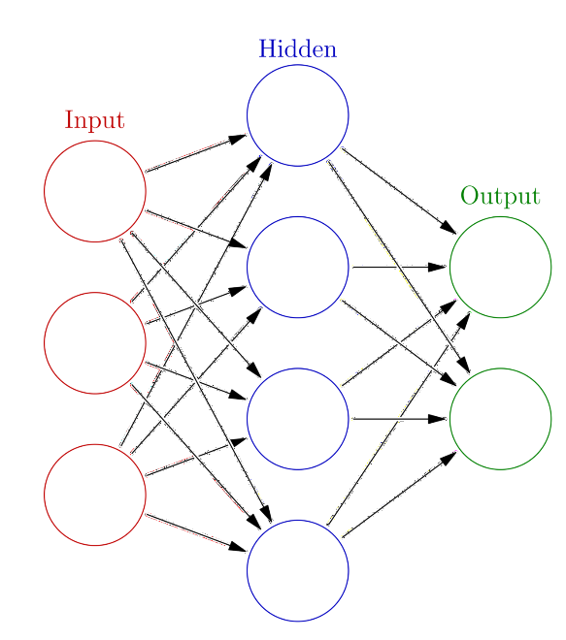
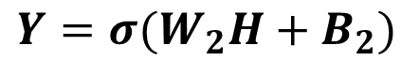
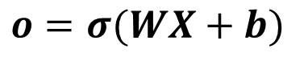
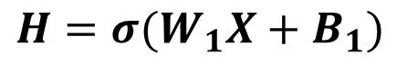
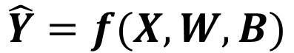
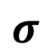
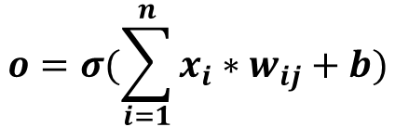
人工神经网络基本结构
$$o=σ(\sum_{i=1}^{n}{x_{i}∗w_{ij}}+b)$$
$$σ$$
$$o=σ(WX+b)$$
b
Bias
W₁ [4*3]
X [3*1]
B₁ [4*1]
H [4*1]
$$H=σ(W_{1}X+B_{1})$$
W₁
W₂
$$Y=σ(W_{2}H+B_{2})$$
W₂ [2*4]
H [4*1]
B₂ [2*1]
Y [2*1]
Y
X
H
$$\hat{Y}=f(X,W,B)$$
4+2=6个神经元 3*4+4*2=20个weight，4+2=6个bias，26个可优化参数

Slide 6
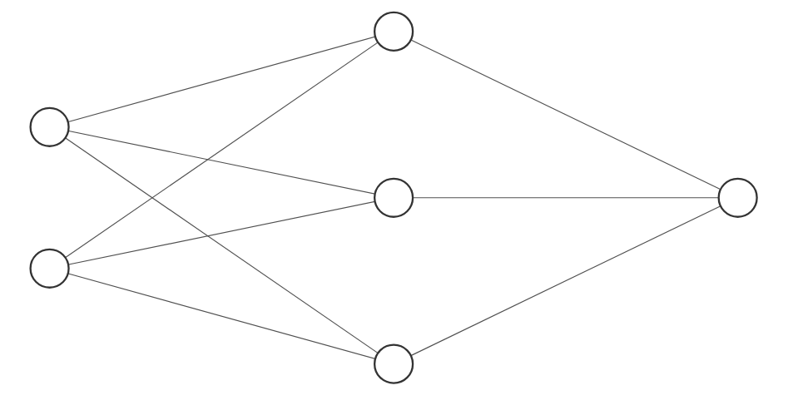

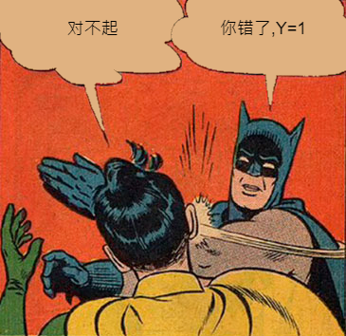
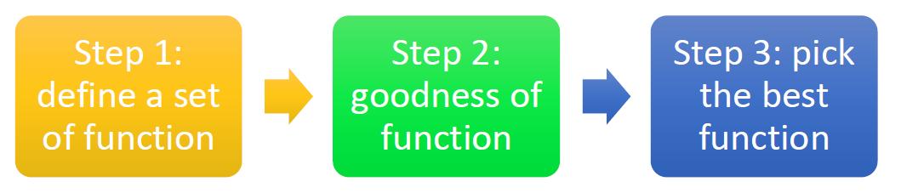
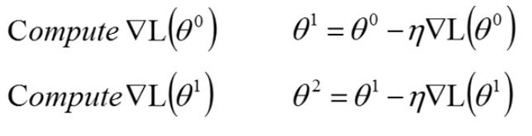
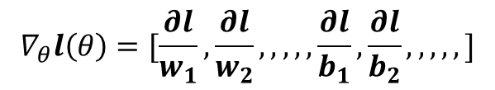
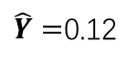
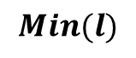
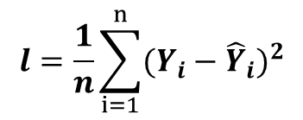
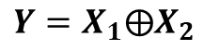
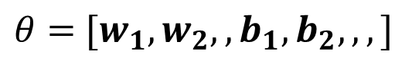
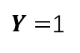
是神经网络是怎么学习的？
Inference，预测
0.2
0.2
0.2
0.2
1
$\hat{Y}=$0.12
X1
0.2
0.2
0.2
0.2
$Y=$1
0
0.2
0.2
X2
0.2
$$l=\frac{1}{n}\sum_{i=1}^{n}{{(Y_{i}−{\hat{Y}}_{i})}^{2}}$$
0.2
Loss Function
Train，训练
$$Min(l)$$
X1 | X2 | Y
1 | 0 | 1
0 | 1 | 1
1 | 1 | 0
0 | 0 | 0
$θ=$ $[w_{1},w_{2},,b_{1},b_{2},,,]$
$$Y=X_{1}⨁X_{2}$$
$$∇_{θ}l\left(θ\right)=[\frac{∂l}{w_{1}},\frac{∂l}{w_{2}},,,,,\frac{∂l}{b_{1}},\frac{∂l}{b_{2}},,,,,]$$

Slide 7
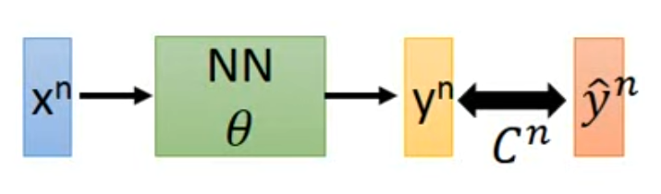
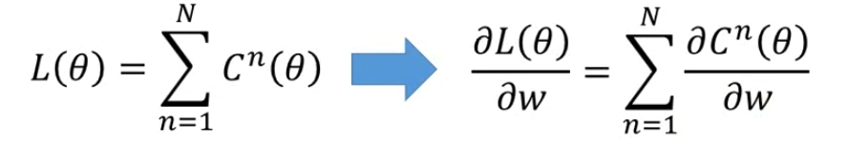
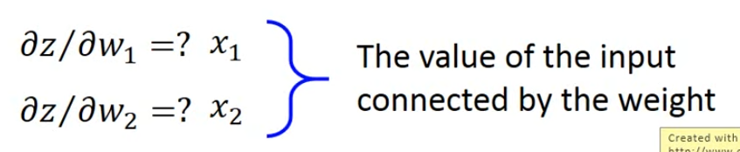
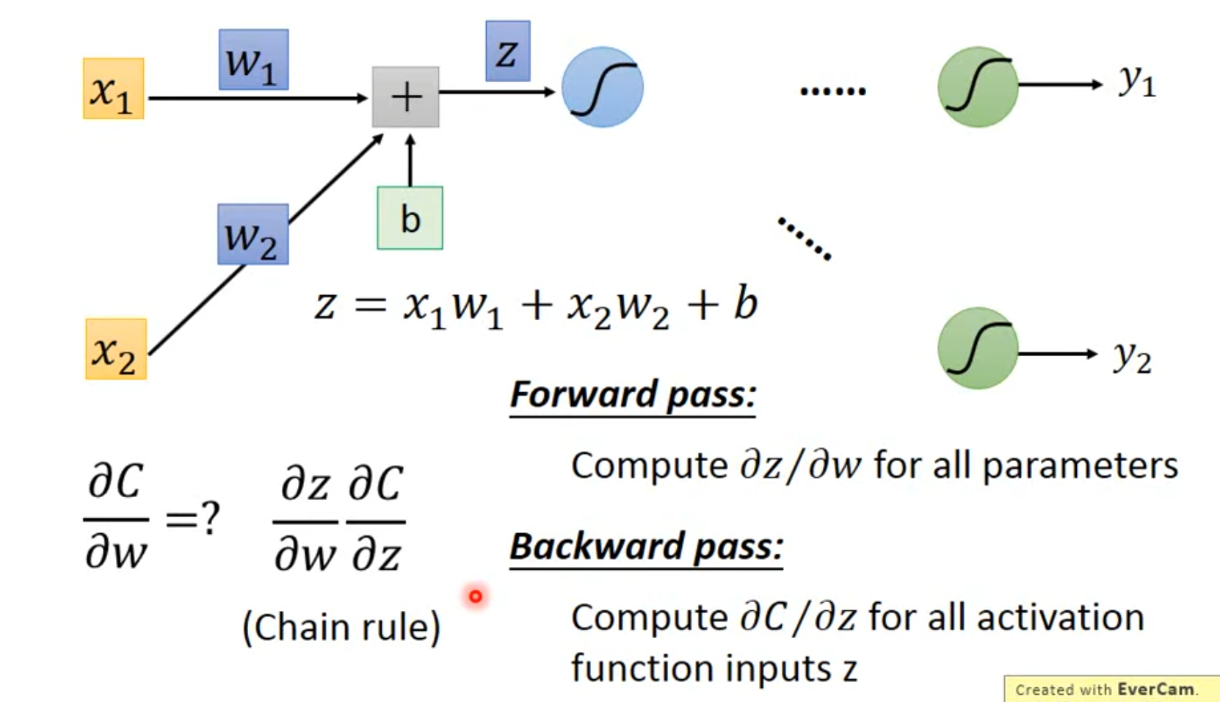
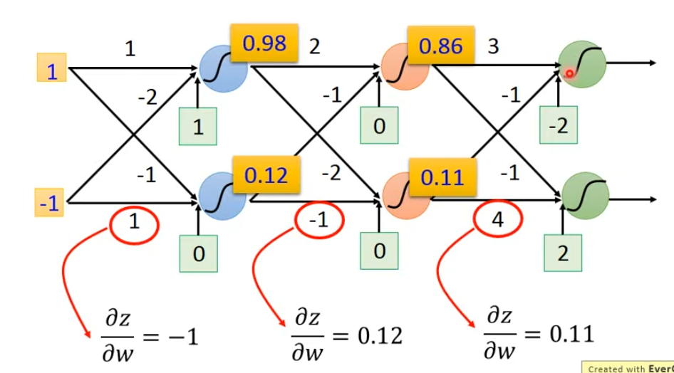
Back propagation
https://www.youtube.com/watch?v=ibJpTrp5mcE&t=230s

Slide 8
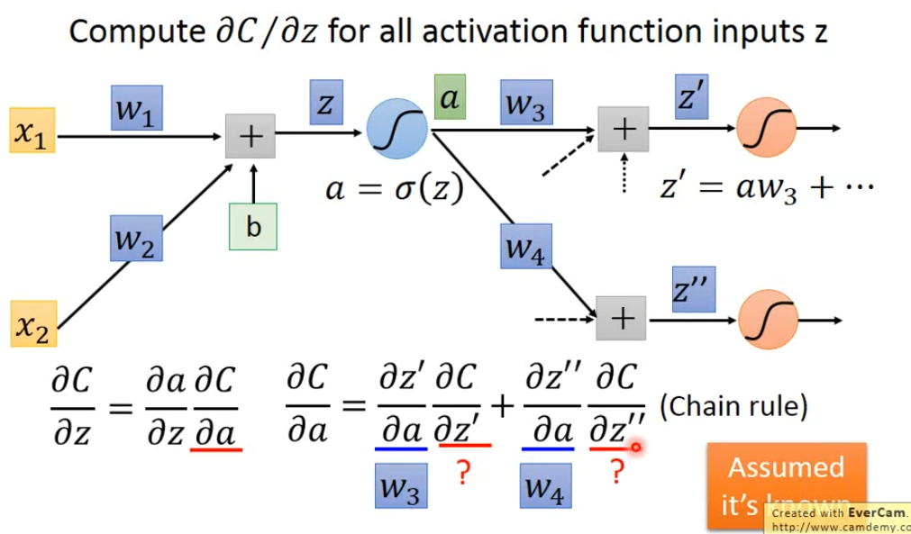
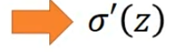
Back propagation
https://www.youtube.com/watch?v=ibJpTrp5mcE&t=230s

Slide 9
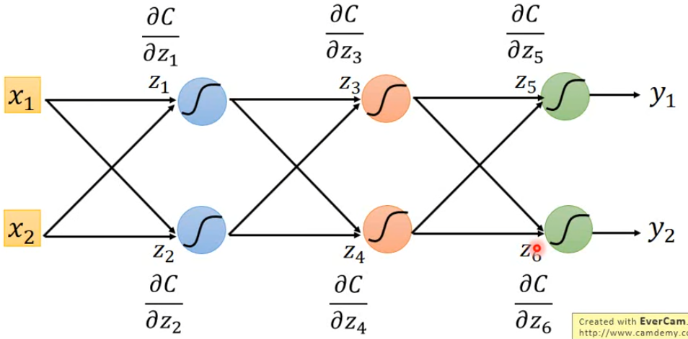
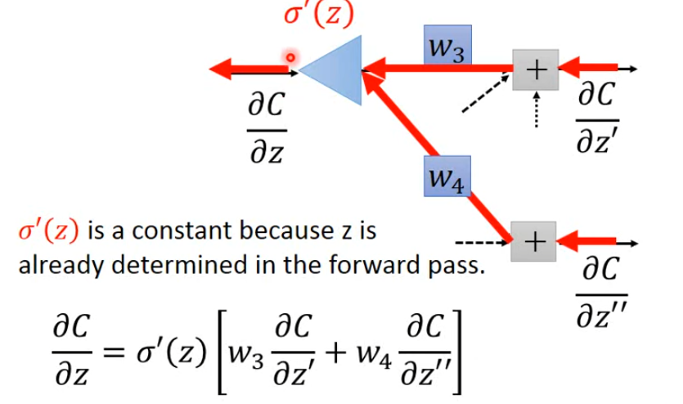
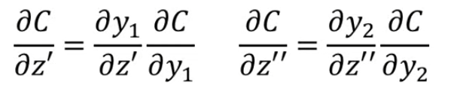
Back propagation
https://www.youtube.com/watch?v=ibJpTrp5mcE&t=230s
Z₅
Z₆

Slide 10
Hands on neural networks
Python
PyTorch
Here you learn
Neural network classification
One hot encoding, cross entropy
data representations (image, pixel, anything)
Pytorch basics

Slide 11
Demo Fashion MNIST hands on —— one hot encoding and cross entropy
One hot —— all bits are ‘0’ except one ‘1’
To transform categorical variables to numeric
One hot is better for nominal data, not having a rank order
Cross Entropy function measures the similarity of the distribution between real and predicted labels
By minimizing cross entropy, the model tends to obtain a better result
For classification, if the labels are one hot encoded, cross entropy should be chosen; if ordinal encoded (1, 2, 3, …), sparse cross entropy should be chosen

Slide 12
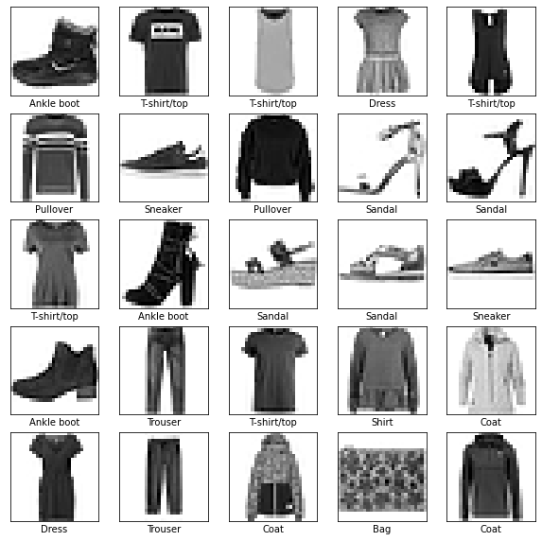
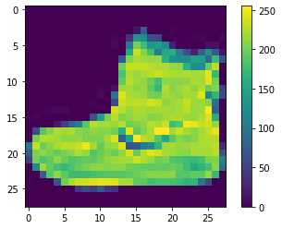
Fashion MNIST hands on —— data representation
10 kinds of clothes in Fashion MNIST, 28*28
Range of each pixel [0, 255]
Divide pixel by 255 to scale the range to [0, 1] for better performance and faster initialization
Flatten the format of two-dimensional 28*28 to one-dimensional 784 as the input.

Slide 13
Demo——Fashion MNIST hands on —— PyTorch basics
PyTorch is an open-source machine learning framework
Basic Steps When You Attempt to Finish a Deep Learning Task:
Explore the data
Preprocess the data
Build the model
Set up the layers
Compile the model
Train the model
Feed the model
Evaluate accuracy or other metrics
Make predictions
Verify predictions
Use your trained model

Slide 14
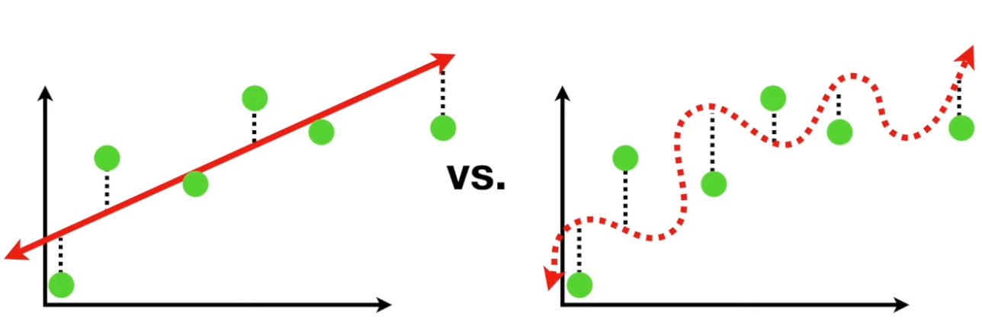
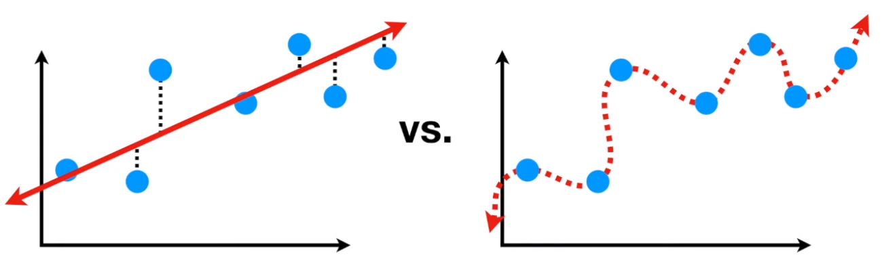
Bias & Variance trade-off
The over fitting problem
More bias less variance
Less bias more variance

Slide 15
Bias-Variance Trade-off
E(MSE) = noise² + bias² + variance
Error due to variance of training samples
Unavoidable error
Error due to incorrect assumptions
See the following for explanations of bias-variance (also Bishop’s “Neural Networks” book):
http://www.inf.ed.ac.uk/teaching/courses/mlsc/Notes/Lecture4/BiasVariance.pdf
Slide credit: D. Hoiem
Notes:
From the link above:
You can only get generalization through assumptions.
Thus in order to minimize the MSE, we need to minimize both
the bias and the variance. However, this is not trivial to do this. For instance, just
neglecting the input data and predicting the output somehow (e.g., just a constant), would definitely minimize the variance of our predictions: they would be
always the same, thus the variance would be zero—but the bias of our estimate
(i.e., the amount we are off the real function) would be tremendously large. On
the other hand, the neural network could perfectly interpolate the training data,
i.e., it predict y=t for every data point. This will make the bias term vanish entirely, since the E(y)=f (insert this above into the squared bias term to verify this),
but the variance term will become equal to the variance of the noise, which may
be significant (see also Bishop Chapter 9 and the Geman et al. Paper). In general,
finding an optimal bias-variance tradeoff is hard, but acceptable solutions can be
found, e.g., by means of cross validation or regularization.

Slide 16
Bias-variance tradeoff
Underfitting
Overfitting
Error
Test error
Training error
High Bias
Low Variance
Complexity
Low Bias
High Variance
Slide credit: D. Hoiem

Slide 17
Bias-variance tradeoff
Few training examples
Test Error
Many training examples
High Bias
Low Variance
Complexity
Low Bias
High Variance
Slide credit: D. Hoiem
Notes:
Note: these figures don’t work in pdf

Slide 18
Effect of Training Size
Fixed prediction model
Error
Testing
Generalization Error
Training
Number of Training Examples
Slide credit: D. Hoiem

Slide 19
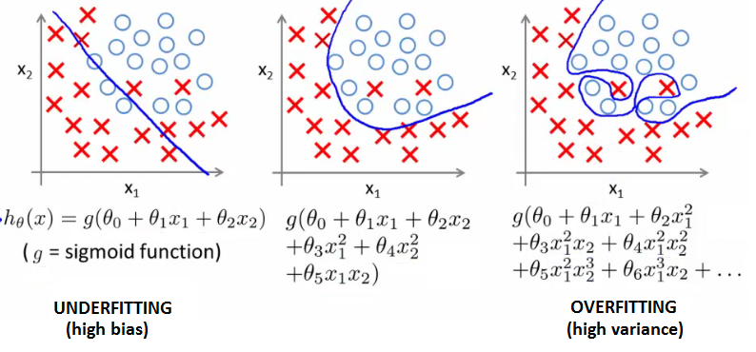
Validation and early-stopping
Validation set is used to adjust the hyper-parameters of the model to finally pick the best of all.
Early-stopping is one of the strategies to prevent model from overfitting.

Slide 20
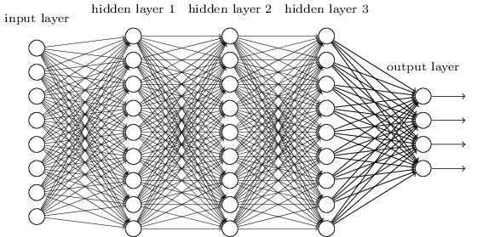
Lecture 5 Smaller Network: CNN
We know it is good to learn a small model.
From this fully connected model, do we really need all the edges?
Can some of these be shared?

Slide 21


Consider learning an image:
Some patterns are much smaller than the whole image
Can represent a small region with fewer parameters
“beak” detector

Slide 22

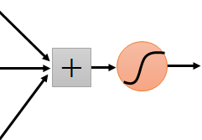
Same pattern appears in different places: They can be compressed! What about training a lot of such “small” detectors and each detector must “move around”.
“upper-left beak” detector
They can be compressed
to the same parameters.
“middle beak” detector

Slide 23
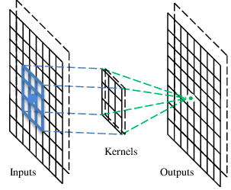
A convolutional layer
A CNN is a neural network with some convolutional layers
(and some other layers). A convolutional layer has a number
of filters that does convolutional operation.
Beak detector
A filter

Slide 24
Convolution
These are the network parameters to be learned.
1 | -1 | -1
-1 | 1 | -1
-1 | -1 | 1
1 | 0 | 0 | 0 | 0 | 1
0 | 1 | 0 | 0 | 1 | 0
0 | 0 | 1 | 1 | 0 | 0
1 | 0 | 0 | 0 | 1 | 0
0 | 1 | 0 | 0 | 1 | 0
0 | 0 | 1 | 0 | 1 | 0
Filter 1
-1 | 1 | -1
-1 | 1 | -1
-1 | 1 | -1
Filter 2
……
6 x 6 image
Each filter detects a small pattern (3 x 3).

Slide 25
Convolution
1 | -1 | -1
-1 | 1 | -1
-1 | -1 | 1
Filter 1
stride=1
1 | 0 | 0 | 0 | 0 | 1
0 | 1 | 0 | 0 | 1 | 0
0 | 0 | 1 | 1 | 0 | 0
1 | 0 | 0 | 0 | 1 | 0
0 | 1 | 0 | 0 | 1 | 0
0 | 0 | 1 | 0 | 1 | 0
Dot
product
3
-1
6 x 6 image

Slide 26
Convolution
1 | -1 | -1
-1 | 1 | -1
-1 | -1 | 1
Filter 1
If stride=2
1 | 0 | 0 | 0 | 0 | 1
0 | 1 | 0 | 0 | 1 | 0
0 | 0 | 1 | 1 | 0 | 0
1 | 0 | 0 | 0 | 1 | 0
0 | 1 | 0 | 0 | 1 | 0
0 | 0 | 1 | 0 | 1 | 0
3
-3
6 x 6 image

Slide 27
Convolution
1 | -1 | -1
-1 | 1 | -1
-1 | -1 | 1
Filter 1
stride=1
1 | 0 | 0 | 0 | 0 | 1
0 | 1 | 0 | 0 | 1 | 0
0 | 0 | 1 | 1 | 0 | 0
1 | 0 | 0 | 0 | 1 | 0
0 | 1 | 0 | 0 | 1 | 0
0 | 0 | 1 | 0 | 1 | 0
3
-1
-3
-1
-3
1
0
-3
-3
-3
0
1
3
-2
-2
-1
6 x 6 image

Slide 28
Convolution
-1 | 1 | -1
-1 | 1 | -1
-1 | 1 | -1
Filter 2
stride=1
Repeat this for each filter
1 | 0 | 0 | 0 | 0 | 1
0 | 1 | 0 | 0 | 1 | 0
0 | 0 | 1 | 1 | 0 | 0
1 | 0 | 0 | 0 | 1 | 0
0 | 1 | 0 | 0 | 1 | 0
0 | 0 | 1 | 0 | 1 | 0
3
-1
-3
-1
-1
-1
-1
-1
-3
1
0
-3
-1
-1
-2
1
Feature
Map
-3
-3
0
1
-1
-1
-2
1
3
-2
-2
-1
6 x 6 image
-1
0
-4
3
Two 4 x 4 images
Forming 2 x 4 x 4 matrix

Slide 29
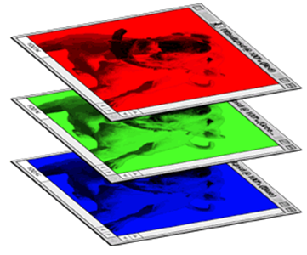
Color image: RGB 3 channels
1 | -1 | -1
-1 | 1 | -1
-1 | -1 | 1
-1 | 1 | -1
-1 | 1 | -1
-1 | 1 | -1
1 | -1 | -1
-1 | 1 | -1
-1 | -1 | 1
-1 | 1 | -1
-1 | 1 | -1
-1 | 1 | -1
1 | -1 | -1
-1 | 1 | -1
-1 | -1 | 1
-1 | 1 | -1
-1 | 1 | -1
-1 | 1 | -1
Filter 1
Filter 2
Color image
1 | 0 | 0 | 0 | 0 | 1
0 | 1 | 0 | 0 | 1 | 0
0 | 0 | 1 | 1 | 0 | 0
1 | 0 | 0 | 0 | 1 | 0
0 | 1 | 0 | 0 | 1 | 0
0 | 0 | 1 | 0 | 1 | 0
1 | 0 | 0 | 0 | 0 | 1
0 | 1 | 0 | 0 | 1 | 0
0 | 0 | 1 | 1 | 0 | 0
1 | 0 | 0 | 0 | 1 | 0
0 | 1 | 0 | 0 | 1 | 0
0 | 0 | 1 | 0 | 1 | 0
1 | 0 | 0 | 0 | 0 | 1
0 | 1 | 0 | 0 | 1 | 0
0 | 0 | 1 | 1 | 0 | 0
1 | 0 | 0 | 0 | 1 | 0
0 | 1 | 0 | 0 | 1 | 0
0 | 0 | 1 | 0 | 1 | 0

Slide 30
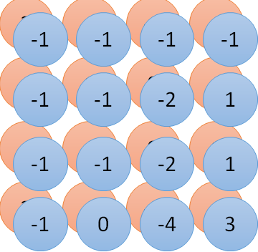
Convolution v.s. Fully Connected
1 | 0 | 0 | 0 | 0 | 1
0 | 1 | 0 | 0 | 1 | 0
0 | 0 | 1 | 1 | 0 | 0
1 | 0 | 0 | 0 | 1 | 0
0 | 1 | 0 | 0 | 1 | 0
0 | 0 | 1 | 0 | 1 | 0
1 | -1 | -1
-1 | 1 | -1
-1 | -1 | 1
-1 | 1 | -1
-1 | 1 | -1
-1 | 1 | -1
convolution
image
1 | 0 | 0 | 0 | 0 | 1
0 | 1 | 0 | 0 | 1 | 0
0 | 0 | 1 | 1 | 0 | 0
1 | 0 | 0 | 0 | 1 | 0
0 | 1 | 0 | 0 | 1 | 0
0 | 0 | 1 | 0 | 1 | 0
Fully-connected
……
……

Slide 31
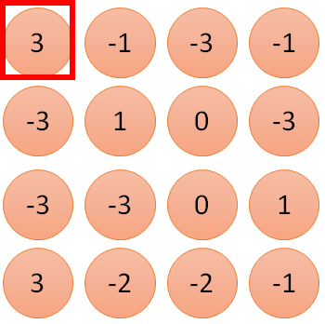
1 | -1 | -1
-1 | 1 | -1
-1 | -1 | 1
1
1
Filter 1
2
0
3
0
3
4:
0
1 | 0 | 0 | 0 | 0 | 1
0 | 1 | 0 | 0 | 1 | 0
0 | 0 | 1 | 1 | 0 | 0
1 | 0 | 0 | 0 | 1 | 0
0 | 1 | 0 | 0 | 1 | 0
0 | 0 | 1 | 0 | 1 | 0
…
0
8
1
9
0
10:
0
…
13
0
6 x 6 image
14
0
fewer parameters!
15
Only connect to 9 inputs, not fully connected
1
16
1
…

Slide 32
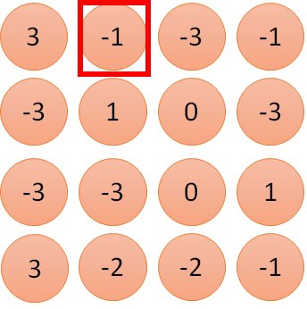
1 | -1 | -1
-1 | 1 | -1
-1 | -1 | 1
1:
1
Filter 1
2:
0
3:
0
3
4:
0
1 | 0 | 0 | 0 | 0 | 1
0 | 1 | 0 | 0 | 1 | 0
0 | 0 | 1 | 1 | 0 | 0
1 | 0 | 0 | 0 | 1 | 0
0 | 1 | 0 | 0 | 1 | 0
0 | 0 | 1 | 0 | 1 | 0
…
7:
0
8:
1
-1
9:
0
10:
0
…
13:
0
6 x 6 image
14:
0
Fewer parameters
15:
1
16:
1
Shared weights
Even fewer parameters
…

Slide 33
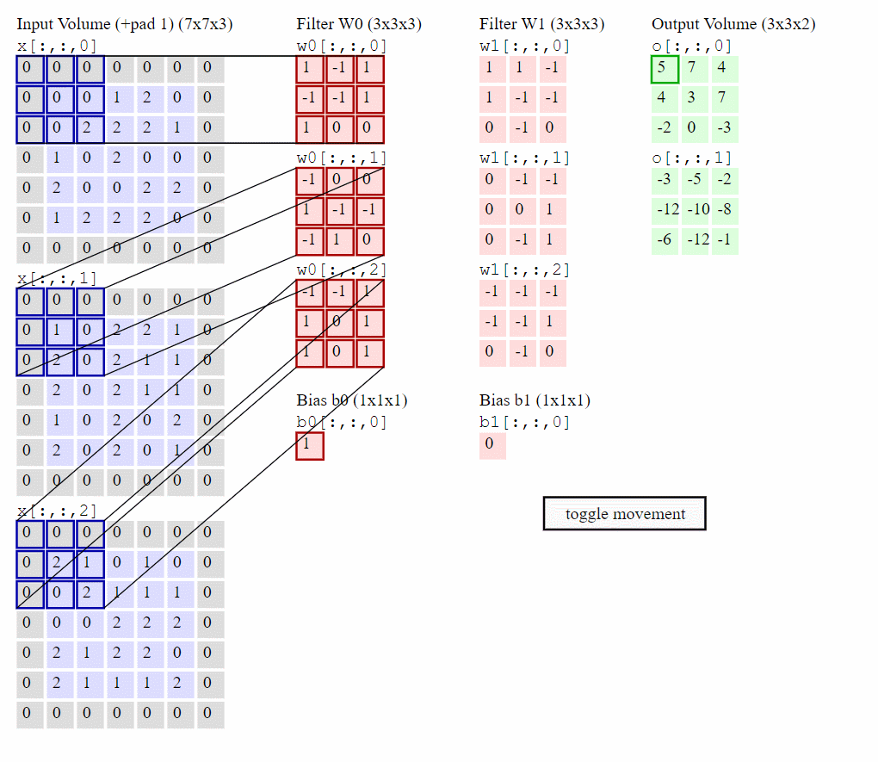

Slide 34


The whole CNN
cat dog ……
Convolution
Max Pooling
Can repeat many times
Fully Connected Feedforward network
Convolution
Max Pooling
Flattened

Slide 35
Max Pooling
1 | -1 | -1
-1 | 1 | -1
-1 | -1 | 1
-1 | 1 | -1
-1 | 1 | -1
-1 | 1 | -1
Filter 1
Filter 2
3
-1
-3
-1
-1
-1
-1
-1
-3
1
0
-3
-1
-1
-2
1
-3
-3
0
1
-1
-1
-2
1
3
-2
-2
-1
-1
0
-4
3

Slide 36


Why Pooling
Subsampling pixels will not change the object
bird
bird
Subsampling
We can subsample the pixels to make image smaller
fewer parameters to characterize the image

Slide 37
A CNN compresses a fully connected network in two ways:
Reducing number of connections
Shared weights on the edges
Max pooling further reduces the complexity

Slide 38
Max Pooling
New image
but smaller
1 | 0 | 0 | 0 | 0 | 1
0 | 1 | 0 | 0 | 1 | 0
0 | 0 | 1 | 1 | 0 | 0
1 | 0 | 0 | 0 | 1 | 0
0 | 1 | 0 | 0 | 1 | 0
0 | 0 | 1 | 0 | 1 | 0
Conv
3
0
-1
1
Max
Pooling
3
1
0
3
2 x 2 image
6 x 6 image
Each filter
is a channel

Slide 39
The whole CNN
3
0
-1
1
Convolution
3
1
0
3
Max Pooling
Can repeat many times
A new image
Convolution
Smaller than the original image
The number of channels is the number of filters
Max Pooling

Slide 40
The whole CNN
cat dog ……
Convolution
Max Pooling
Fully Connected Feedforward network
A new image
Convolution
Max Pooling
Flattened
A new image

Slide 41
Flattening
3
0
1
3
0
-1
1
3
3
1
-1
0
3
Flattened
1
Fully Connected Feedforward network
0
3

Slide 42
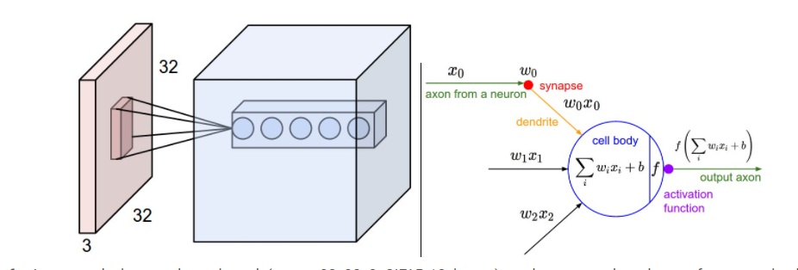
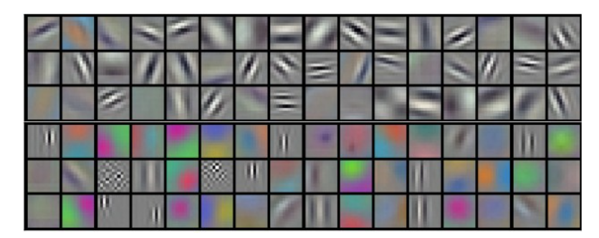

Convolutional Neural Network (CNN)
https://cs231n.github.io/convolutional-networks/

Slide 43



Slide 44
CNN Demo, Improve the Fashion MNIST
CNN
Train Test Validation split
Early stopping

Slide 45


CNN in Keras
Only modified the network structure and input format (vector -> 3-D tensor)
input
Convolution
1 | -1 | -1
-1 | 1 | -1
-1 | -1 | 1
-1 | 1 | -1
-1 | 1 | -1
-1 | 1 | -1
There are 25 3x3 filters.
……
Max Pooling
Input_shape = ( 28 , 28 , 1)
28 x 28 pixels
1: black/white, 3: RGB
Convolution
3
-1
3
Max Pooling
-3
1

Slide 46
CNN in Keras
Only modified the network structure and input format (vector -> 3-D array)
Input
1 x 28 x 28
Convolution
How many parameters for each filter?
9
25 x 26 x 26
Max Pooling
25 x 13 x 13
Convolution
How many parameters
for each filter?
225=
25x9
50 x 11 x 11
Max Pooling
50 x 5 x 5

Slide 47

CNN in Keras
Only modified the network structure and input format (vector -> 3-D array)
Input
1 x 28 x 28
Output
Convolution
25 x 26 x 26
Fully connected feedforward network
Max Pooling
25 x 13 x 13
Convolution
50 x 11 x 11
Max Pooling
1250
50 x 5 x 5
Flattened

Slide 48
Cifar-10 homework

